Slide 1
PROJECT UPSKILL PRESENTS
NETWORKING ON LINKEDIN
[DATE OF WORKSHOP]
Presented by: [Insert name]
Notes:
Facilitator notes:
You may be perceived as institutional agents (individuals who have status, authority, and access to resources within institutions, i.e. teachers, counselors, etc.) by first-generation college students

Slide 2
Project Upskill
HOW DO I REACH OUT TO PEOPLE ON LINKEDIN?

Slide 3
Project Upskill
WORDS OF WISDOM
Do not wait until you're applying to jobs to start networking; you're too late!!!
Job, pleeeaaaaasssssse!
Credit: Austin Henline

Slide 4
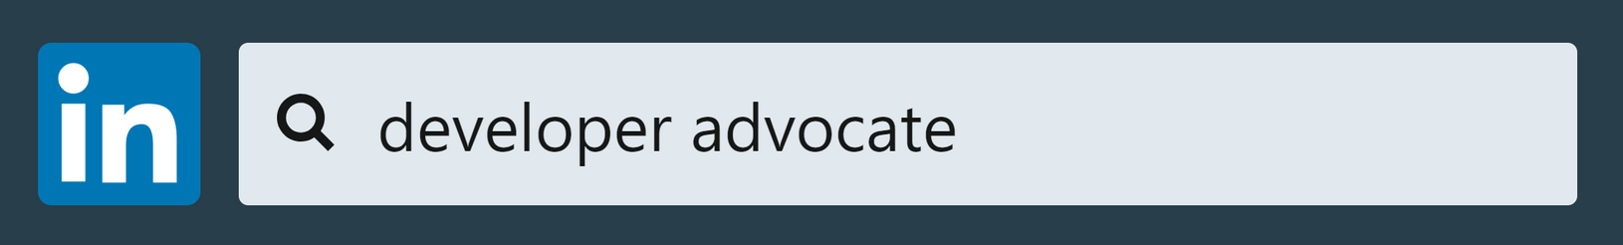
Project Upskill
HOW DO I FIND PEOPLE?
Credit: Austin Henline

Slide 5
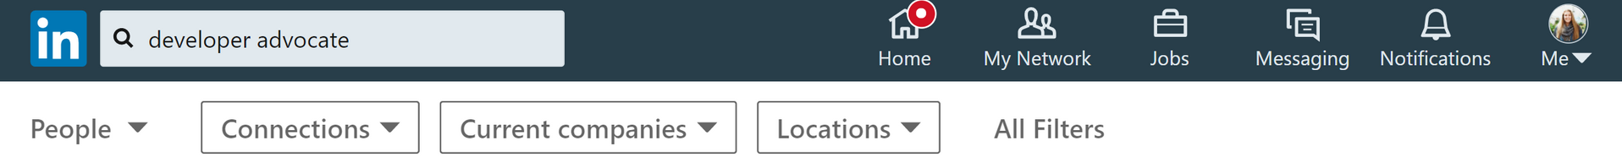
Project Upskill
HOW DO I FIND PEOPLE?
Credit: Austin Henline

Slide 6
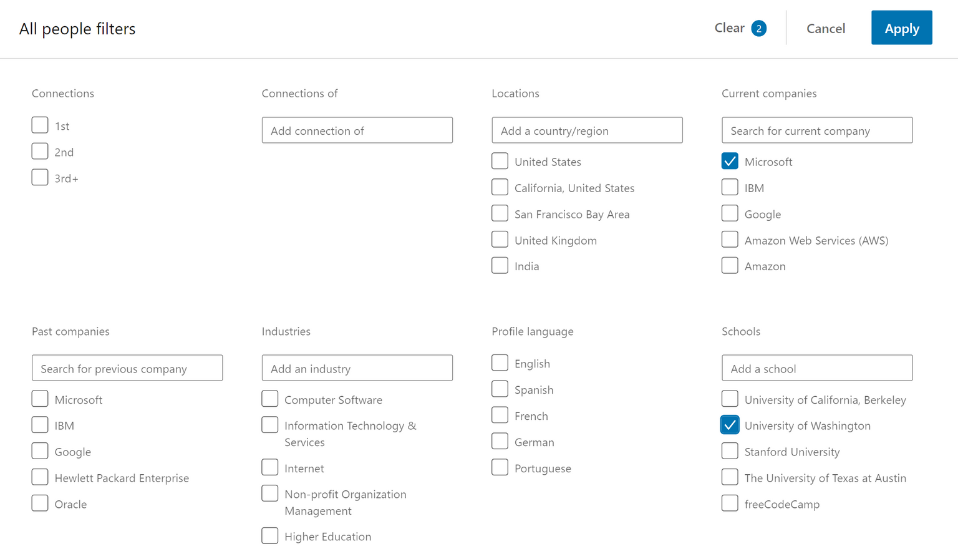
Project Upskill
HOW DO I FIND PEOPLE?
Credit: Austin Henline

Slide 7
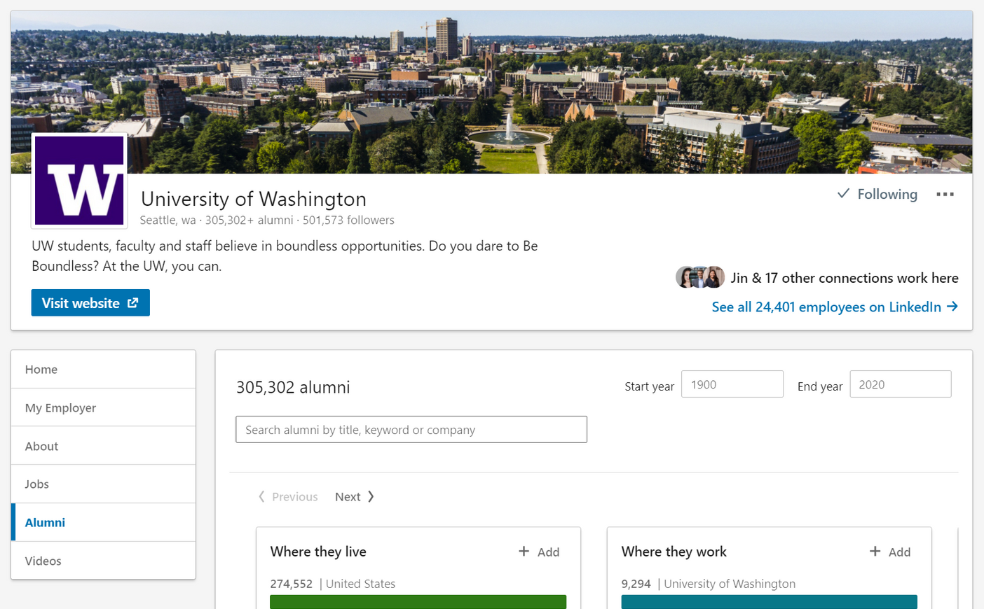
Project Upskill
HTTPS://WWW.LINKEDIN.COM/SCHOOL/UNIVERSITY-OF-WASHINGTON/PEOPLE/
ALUMNI SEARCH TOOL:
Credit: Caitlin Goldbaum

Slide 8
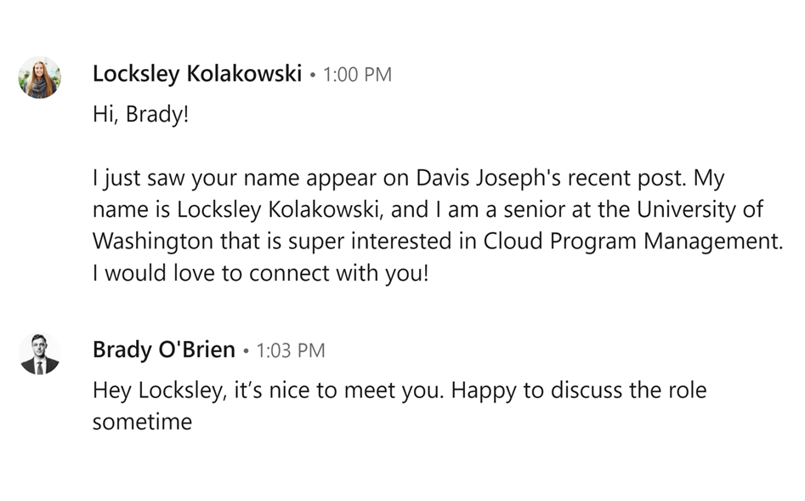
Project Upskill
SENDING A CONNECTION REQUEST
State the connection you have with them
Went to the same school
Worked at the same company
Include something personal to show that you did research
A kind connection request
Why, specifically, do you want to connect with THEM?
Credit: Austin Henline

Slide 9
Project Upskill
A COUPLE THINGS TO KEEP IN MIND:
If they don't respond, that's okay!
Don't give up
Assume good intentions
Interns are a really great first connection at a company you're interested in
Don't undervalue yourself
The worst thing that can happen is they never respond

Slide 10
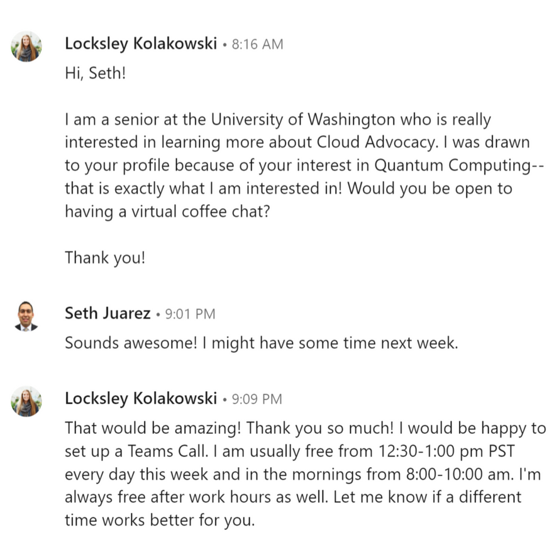
Project Upskill
SCHEDULING A "COFFEE CHAT"
Find something in their profile you want to learn about
A potential subject/role you find interesting
A project you admire
Have a specific ask
"Is there a time you're free for a 30 minute, virtual coffee chat?"
Make it about them and their experiences
No asking for referrals yet!
An exit clause
Make it low pressure to accept
Credit: Austin Henline
Notes:
Facilitator notes:
Activity to conduct: have attendees find one person on LinkedIn to schedule a meeting with

Slide 11
Project Upskill
HOW DO I PREPARE FOR A COFFEE CHAT?

Slide 12



Project Upskill
THE VIDEO PLATFORM/LOCATION
Will this be a video chat?
If you can, use the video platform they use for work
Prepare using this video platform before you meet with them
Will this be in person?
Choose a location that is nearby to their office
In both circumstances, avoid any distractions like your phone!

Slide 13
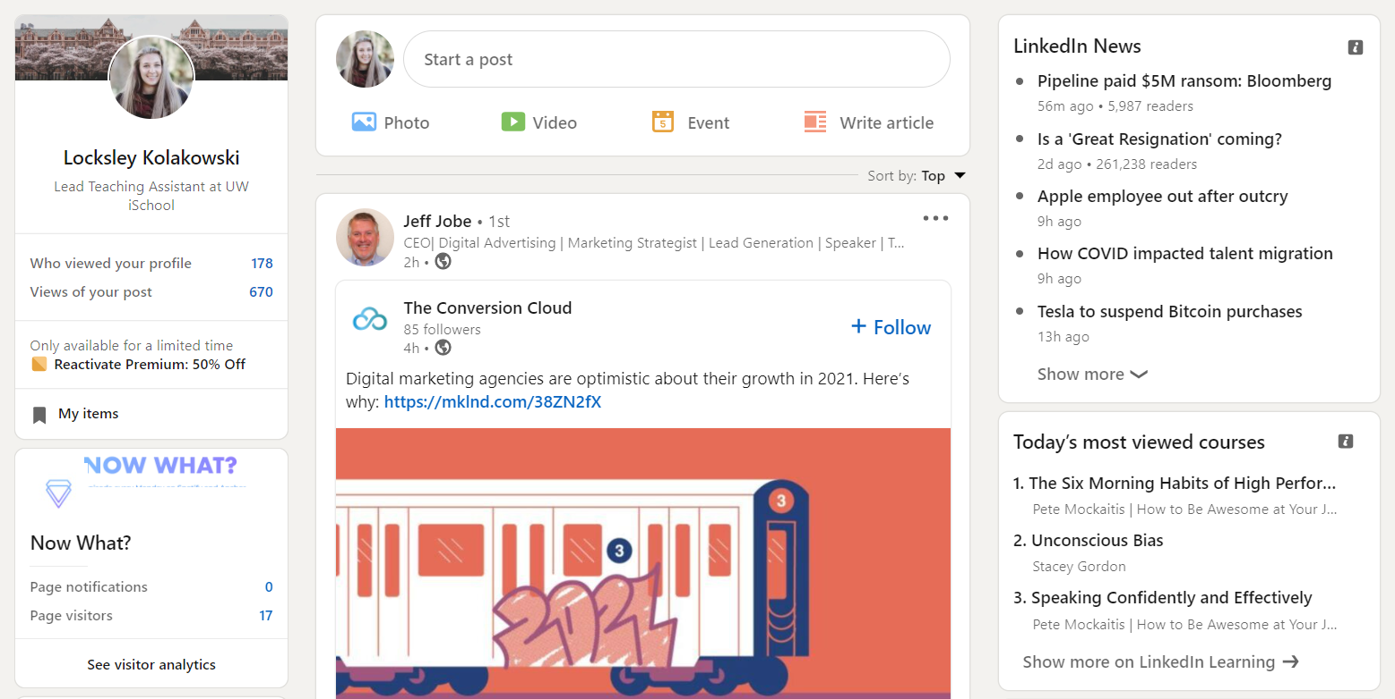


Project Upskill
CONDUCT RESEARCH!
This will vary by person, position, company, and background
A couple places you should search are
LinkedIn profile/posts
Personal website
Twitter
Recent blog posts
Publications
Notes:
Conduct more research on the person. (Don’t waste their time!)
LinkedIn profile/posts, Personal Website, Twitter, recent blog posts/writings
Their position
Create a list of questions to ask.
The questions you ask will be unique to who you’re going to chat with
Why x company, education, skills you needed to get that role
What books do you recommend?
If I’m interested in this position/company, who could you connect me to talk with next?
Questions not to ask:
What do you do in your position

Slide 14
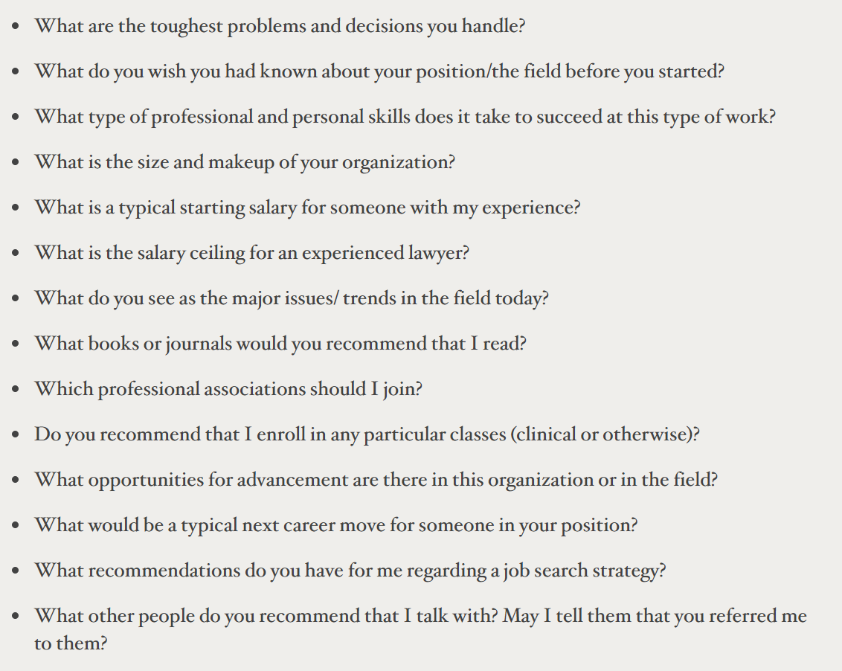
Project Upskill
PREPARE A LIST OF QUESTIONS
The questions you ask will be unique to who you’re going to chat with
How did that experience prepare you for your current role?
What books do you recommend?
Always end the conversation with an ask
“If I am interested in this role, who would you recommend I speak to next? Could you introduce me?”
Coffee chats should be a two-way street
Ask a question like: “Thank you for your time; is there anything I can do for you?”
List of networking questions to ask from Harvard Law School

Slide 15
Project Upskill
WHAT DO I DO AFTER THE COFFEE CHAT?

Slide 16
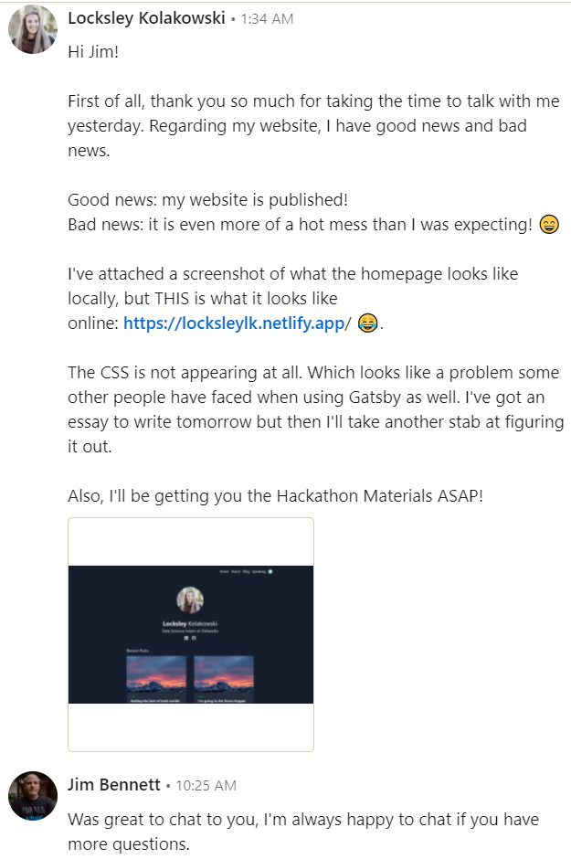
Project Upskill
ADVICE + NEXT STEPS
Immediately send a thank you
Show you appreciate their time
Highlight specific parts of the conversation that helped you
Choose whether to stay in touch
If it wasn’t a good fit, don’t feel pressured to stay in contact
If it was a good fit, set time on your calendar to follow up with them once every ~3 months
Build social capital
A one-time meeting will not build trust
Long-term professional relationships is what leads to referrals and other opportunities
Notes:
Facilitator notes:
An interesting follow-up NYT article to read after going through this workshop relating to how you can be more effective when attempting to network: https://www.nytimes.com/2017/08/24/opinion/sunday/networking-connections-business.html

Slide 17
Project Upskill
THANK YOU!
Questions?
This event would not be possible without Caitlin Goldbaum, Austin Henline, and Cass McCrory. Thank you!
Notes:
Decided to meet with you, how do you prepare for the meeting?
How do you prepare for the meeting?
Conduct more research on the person. (Don’t waste their time!)
LinkedIn profile/posts, Personal Website, Twitter, recent blog posts/writings
Their position
Create a list of questions to ask.
The questions you ask will be unique to who you’re going to chat with
Why x company, education, skills you needed to get that role
What books do you recommend?
If I’m interested in this position/company, who could you connect me to talk with next?
Questions not to ask:
What do you do in your position
Always have an ask at the end.
Can you connect me with someone I can talk to?
Books you can recommend to me?
Don’t let it be a one-time thing.
Build up trust, continue checking back with them
Building social capital
A 1-time, 30 minute meeting won’t do it
It is a two-way street
Conduct research on what a student can offer
“Thank you for your time; is there anything I can do for you?”
What do you do during the meeting?
What do you do after the meeting?
Immediate send a thank you to them - summarize what you heard
Stay in touch (3-month intervals - that depends on the situation)
Put it on your calendar to reach out to them every 3 months
Doesn’t need to be an official video call; can just drop an email, connect it back to your last conversation
List of good resources people can read
What we will deliver
2 “modules” - slide deck + information/instructions
This Wednesday
Hand-off close-out documentation
Set up a meeting with the WINFO/IUGA officers to let them know about these resources
Need to create links with organizations/clubs
Next steps: established meetings with these organizations to let them know about this resource
This Thursday
Send out a meeting invite
@Lynzley
Redoing the landing page structure (you should work with Jove on this)
Landing/ workshops/about page
Add in the PowerPoints to the webpage
PowerPoint is not set in stone
@Locksley
Synthesize all of the information above and add it to the networking slide deck
@Jove
Hard-review of the content - is it understandable?
Research for really good articles to read before/after the workshop
Increased focus for first-gen college students - how can we bring this focus back?
Might need to be something done with the facilitators -> figure out how to make this clear
Being inclusive of first-generation students is our intent -> make a focused effort of this
@Rawuda
Poster
Hard-review of the content - is it understandable?
Testing with the user - can they understand this from an outside perspective
Add on to the documentation -> facilitator notes
Increased focus for first-gen college students - how can we bring this focus back?
This Friday
Webpage - make the landing page a webpage :)
Does not have to look exactly like the template
Each of the modules can be on their own page
Imbedded Slide Deck???
Need an easy way to download the deck for officers to edit
About the project page
Include a link to the “documentation” from here
We should send them an email at the end of the quarter to let them know
Product Demo + Presentation
Poster
Our actual deadline is May 27
Extra resources
Documentation of how to use the modules + next steps people can take to contribute future workshops
Audience -> facilitator/individual
Can a first-gen college student use GitHub/GitHub pages?

